Slide 1




Intro to Python
Create your own story generator
"Intro to Pandas" by Sheldon Korpet is licensed under CC BY 4.0

Slide 2
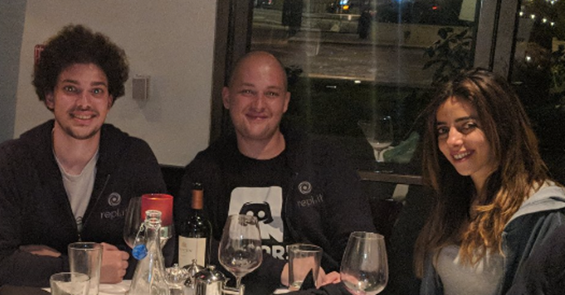
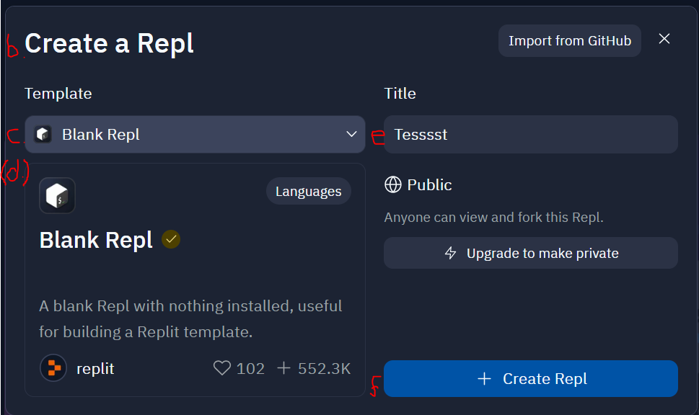
Creating a Repl
a. Go to https://replit.com/ and sign in
b. Click “+ Create Repl”
c. Change “Blank Repl” to ‘Python’
d. It will show underneath
e. Give your repl a name e.g. story_generator
f. Click “+ Create Repl”
Faris Masad, Amjad Masad and
Haya Odeh, Inventors of Replit
Repl:
“an online integrated development environment (IDE) that allows developers to create small projects and run their programs”

Slide 3

Today’s intro task
Python:
A general-purpose programming language, created by Guido van Rossum and first released in 1991.
Executing a program:
A complex process where the computer translates the instructions we’ve given down to binary (1010101) for the processor.
We will create a story generator by coding in Python.
Mindset:
YOU MUST CODE BADLY
The best way to learn to code is to code badly until you can code well (much like learning to write).
CODING IS AN ACTION
Think of coding as an action and the output will be a digital file which may or may not run (‘Run’ is another word for ‘executing code’).

Slide 4
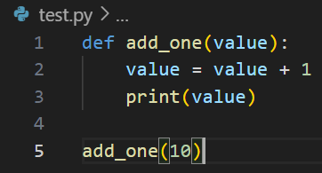
The basic basics
Variables:
a name that is used to refer to a value stored in the computer's memory
Example of a function:
add_one is the function,
the value between the () is the argument aka arg
The arg (10) is passed to the function add_one. The output will be 11.
Variables are like keywords for containers which hold values. The variable below, first_name, holds the value Sheldon
first_name = ‘Sheldon’
You write values which are words into a variable with flying commas, but you do not use them for numbers e.g.
age = 32
Functions are bits of pre-created code which you call with a keyword and parenthesis e.g.
print(‘Sheldon’)
The print() function tells Python to output Sheldon to the console (the big empty window on the right)
You can find a list of these functions which are built into Python here: https://docs.python.org/3/library/functions.html

Slide 5
Basic elements of our program
Computer program:
“a way of giving instructions to a computer about what it should do next.”
Comments
Variables
Functions
If there is time:
Lists
Libraries

Slide 6
Data Types in Variables
Data types:
used to define the type of a variable and what type of data can be stored in it
Numeric types – intergers, floating numbers, complex numbers
Sequence types – lists, tuples, ranges
Boolean types – True or False values
Mapping type - dictionaries
In Python, we call text (like what you’re reading now) strings or str
When you write strings in your program you surround them like this value assigned to a variable
name = ‘Sheldon’
OR name = “Sheldon”
Both of the above are exactly the same
In Python, numbers are called integers or int. They can just be typed e.g.
age = 32

Slide 7
ADVANCED - formatting (PEP 8)
In Python, there is a correct way of formatting the code you type. This is for two main reasons:
Code execution – so the computer can interpret it correctly
2. Code readability – humans can read the code easier if it’s not in one giant line
E.g. when defining variables, give them new lines:
name = ‘Sheldon’
age = 32
department = ‘library’
city_of_birth = ‘Leeds’
current_address = ‘Manchester’
Naming variables
Use a lowercase single letter, word, or words. Separate words with underscores to improve readability.

Slide 8
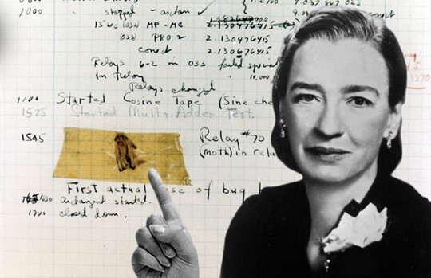
Debugging
When looking for problems in your code try:
Looking for typos e.g. prnt()
Checking your syntax e.g. print)
Look for logical errors e.g. your program can’t use a variable before you specify it
What is debugging?
Finding errors in your code.
Fun fact:
The term "debugging" originated in 1947 when Grace Hopper, a computer scientist and U.S. Navy Rear Admiral, found a moth that had gotten stuck in one of the computer's relays.

Slide 9
Debugging (expanded)
There are 3 types of common errors which can occur in Python:
1. Syntax errors – Python expects symbols (aka punctuation), to follow a protocol, indentation matters and keywords need to be spelt correctly
2. Runtime errors – a program encounters a condition it did not expect when trying to run e.g. trying to read data from a file which it can’t local or doesn’t exist.
3. Logical errors – there were no syntax or runtime errors but the output is not what was expected e.g. wrong function was used.
How do I read errors?
From the bottom – last line, up.

Slide 10
Basic elements of our program
Comments
# comments are formatted like this
# comments explain what your code is doing
Variables
variable = ‘a value assigned to a keyword’
name = ‘sheldon’
user_number = 19
Functions
print(“This is how we format this function”)
print(42)
Lists
shopping_list = [‘apple’, ‘banana’, ‘cherry’ ]
lotto_numbers = [2,19,45,67,34,39]
Libraries
import random
There are lots and they can be found here https://pypi.org/
Naming Variables:
Don’t use use any of the Python keywords to name your variables! List here
Computer program:
“a way of giving instructions to a computer about what it should do next.”

Slide 11
What now?
Want to learn to code for a specific reason?
If you want to try coding but Python is too hard, consider:
Scratch or ‘Web design’ using the Rasberry Pi foundations courses (they’re aimed at kids but absolutely no reason adults can’t use them).
There are many other courses and MOOCs on Youtube, Udemy, freeCodeCamp, e.g. practical beginners Python course here, Odin Project, Mimo, Codecademy, Datacamp, Sololearn, Brilliant etc.
I personally like the Mimo app for recapping what I’ve learnt on Linkedin or Youtube but choose whatever resource works for you.
I want to… | Language
Call from APIs | Python + JSON
Build websites | HTML, CSS, Javascript, Typescript, Python, Ruby on Rails, PHP
Analyse data | Python, R
Train machine learning models | Python, Julia
Code computer programs | Python, Rust, SQL, C/C#/C++
Search databases and Wikidata | SQL
OCR/digitisation | Python
Build mobile apps | Kotlin, Swift

